Slide 1
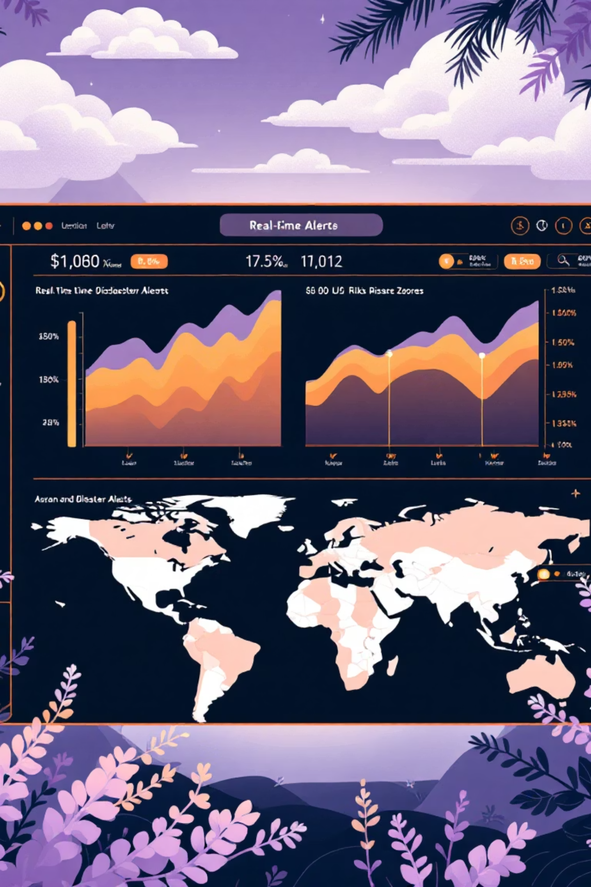
🌪 Disaster Prediction & Early Alert Dashboard
A Real-Time Soluti}n for Enhanced Safety

Slide 2


DISASTER PREDICTION & EARLY ALERT DASHBOARD
Abstract
This web dashboard provides real-time data on natural disasters, including earthquakes, floods, cyclones, and forest fires. It offers live alerts, data-driven predictions, and an interactive map highlighting high-risk zones, aiming to provide early warnings and minimize damage.

Slide 3

The Urgent Need: Addressing Delayed Warnings
Millions of lives are impacted annually due to delayed disaster warnings. Current warning systems are often fragmented, complex, or not user-friendly, hindering timely response.
A simple, centralized, and intuitive dashboard is crucial for immediate access to real-time alerts and accurate risk predictions, empowering communities to act swiftly.
Our solution aims to bridge this critical gap, providing clear, actionable information when it matters most.

Slide 4
Purpose of the Dashboard
1
2
3
Real-Time Updates
Predict Risk Levels
Enhance Preparedness
Deliver immediate, accurate disaster information as events unfold.
Utilize data and algorithms to forecast potential disaster impacts.
Empower individuals and organizations to prepare proactively.
4
5
Mitigate Impact
Educate Users
Reduce casualties and property damage through early intervention.
Provide essential safety measures and guidelines for various scenarios.

Slide 5
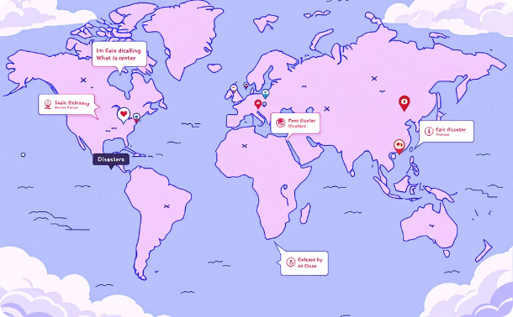



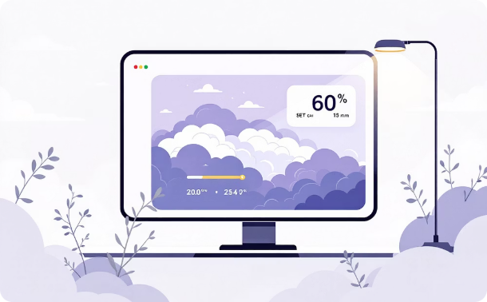
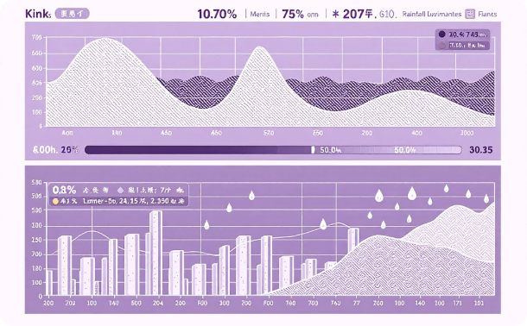
🔥 Key Features: Empowering Preparedness
Interactive Map
Real-Time Alerts
Prediction Engine
Safety Tips & Contacts
Visualize disaster zones globally with intuitive, color-coded markers.
Instant updates on earthquakes, floods, cyclones, and wildfires via public APIs.
Leverage algorithms to forecast risk levels (Low, Medium, High) based on climatic and seismic data.
Dedicated sections for disaster-specific precautions and crucial emergency contacts.
Weather Integration
Live Data Graphs
Integrate real-time weather forecasts to predict storms, heavy rainfall, and heatwaves.
Visual representation of vital environmental metrics: rainfall, temperature, and seismic activity.

Slide 6






How the System Works: A Seamless Workflow
1. Data Acquisition
Website fetches real-time data from various disaster and weather APIs.
2. Data Processing
Raw data undergoes cleaning and processing for accuracy and usability.
3. Predictive Analysis
Integrated logic checks for rainfall patterns, climatic conditions, and seismic changes.
4. Alert Generation
System displays live alerts and computed risk levels to users.
5. Map Visualization
Interactive map updates dynamically with warnings and high-risk areas.
6. User Guidance
Users receive recommended safety actions and preparedness measures.

Slide 7


Tech Stack Suggestions: Building the Foundation
Option A: MERN Stack (Modern & Robust)
Option B: Flask (Lightweight & Efficient)
Ideal for a scalable and dynamic application with a rich user interface.
Excellent for rapid development and clean, Python-based backend.
MongoDB: Flexible NoSQL database for dynamic data.
Python: Versatile language for backend development and scripting.
Express.js: Robust backend framework for API handling.
Flask: Micro-framework for building web applications.
React: Modern frontend library for interactive UIs.
HTML/CSS/JS: Standard frontend technologies for presentation.
Node.js: JavaScript runtime for server-side logic.
APIs: Integration with external disaster data sources.
Mapping Libraries: Leaflet.js or Mapbox for advanced map functionalities.
Mapping Libraries: Folium or Leaflet for map visualizations.
Charting: Matplotlib or Chart.js for data visualization.

Slide 8

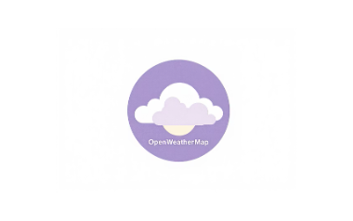



Real-Time Data Sources: Powering the Dashboard
The dashboard relies on robust, reliable data sources to provide accurate and timely information. These APIs offer access to a wide range of disaster and weather data:
USGS Earthquake API: Provides comprehensive earthquake data worldwide.
OpenWeatherMap API: Offers real-time weather data and forecasts.
NASA Fire Data API: Supplies satellite-derived wildfire information.
GDACS Alerts API: Global Disaster Alert and Coordination System.
IMD Weather (India): Indian Meteorological Department for regional weather.
Flood Monitoring APIs: Various sources for river levels and flood predictions.

Slide 9





Future Scope: Evolving for Greater Impact
AI-Based Prediction
Integrate advanced AI/ML models for more precise disaster forecasting.
Mobile Alert App
Develop a dedicated smartphone application for on-the-go alerts.
SMS Warning System
Implement an SMS-based system to reach users without internet access.
Evacuation Maps
Provide real-time, dynamic evacuation routes during emergencies.
Crowd-Sourced Reports
Enable users to report localized incidents, enhancing data accuracy.

Slide 10

Thank You!
We deeply appreciate your time and attention today. Your engagement and insights are vital as we work to build a safer future.
Presented by:
RAGHU
HRUSHIK
ZAKI
RAHUL
SATHWIK
ADITYA

